Slide 2


Slide 3
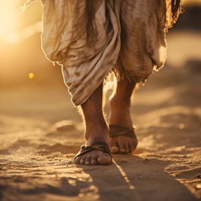
What Does That
Really Mean?
Can We Walk
Righteously
With Our Lord?

Slide 4

What Does The Bible Actually Teach?

Slide 5
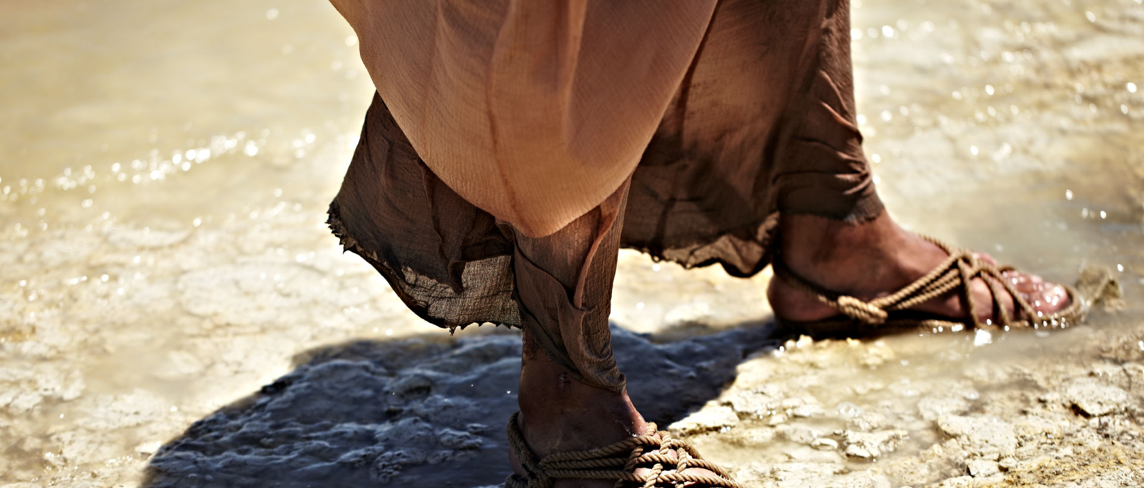
(5) This is the message we have heard from Him and announce to you, that God is Light, and in Him there is no darkness at all. (6) If we say that we have fellowship with Him and yet walk in the darkness, we lie and do not practice the truth; (7) but if we walk in the Light as He Himself is in the Light, we have fellowship with one another, and the blood of Jesus His Son cleanses us from all sin. (8) If we say that we have no sin, we are deceiving ourselves and the truth is not in us. (9) If we confess our sins, He is faithful and righteous, so that He will forgive us our sins and cleanse us from all unrighteousness. (10) If we say that we have not sinned, we make Him a liar and His word is not in us. (1 John 1)
Can We
Walk Righteously
With Our Lord?
Yes!

Slide 6
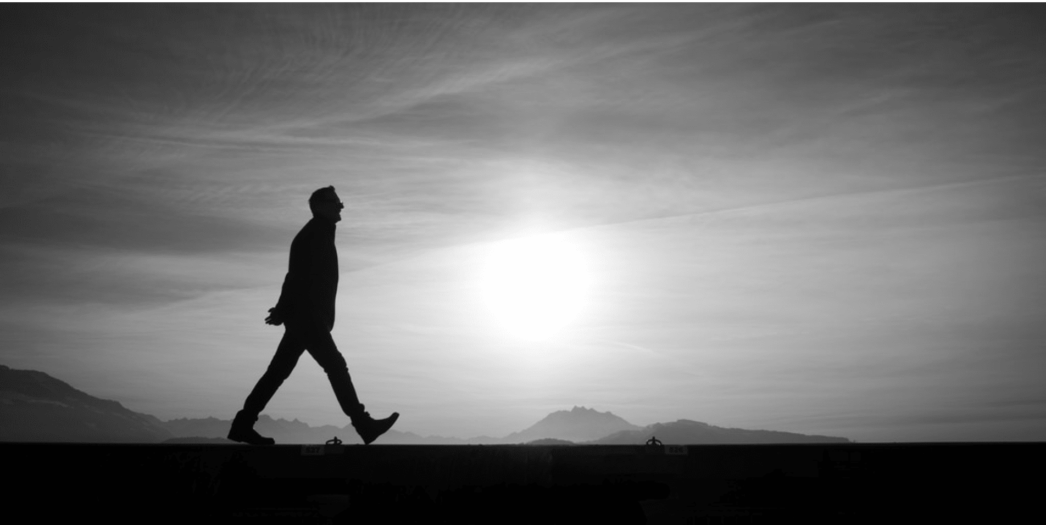
(1) My little children, I am writing these things to you so that you may not sin. And if anyone sins, we have an Advocate with the Father, Jesus Christ the righteous; (2) and He Himself is the propitiation for our sins; and not for ours only, but also for the sins of the whole world. (3) By this we know that we have come to know Him, if we keep His commandments. (4) The one who says, “I have come to know Him,” and does not keep His commandments, is a liar, and the truth is not in him; (5) but whoever follows His word, in him the love of God has truly been perfected. By this we know that we are in Him: (6) the one who says that he remains in Him ought, himself also, walk just as He walked. (2:1-6)
Yes!
Can We Walk Righteously In This Broken World?

Slide 7
“Little children, let no one deceive you: The one who practices righteousness is righteous, just as Christ is righteous.” (1 John 3:7)
Yes!
Can We Walk Righteously In This Broken World?

Slide 8
(34) Opening his mouth, Peter said: “I most certainly understand now that God is not one to show partiality, (35) but in every nation the man who fears Him and does what is right is welcome to Him.” Acts 10:34-35
Yes!
Cf. Ezekiel 18
Can We Walk Righteously In This Broken World?

Slide 9
Justify Same Expression As Declared Righteous
The Legacy Standard Bible translates "justified" and "righteous" using a literal, formal equivalence approach, closely following its predecessor the NASB by consistently rendering the Greek verb dikaioō as forms of justify/declared righteous and the noun/adjective family (dikaiosunē / dikaios) as righteousness/righteous.
Translation Characteristics
Justified (dikaioō): Rendered as "justified" or "declares righteous" (e.g., Romans 5:1, Romans 4:5), preserving the forensic, legal concept of a divine declaration rather than moral infusion.
Righteous / Righteousness (dikaios / dikaiosunē): Rendered strictly as "righteous," "righteousness," or "just," maintaining direct word-family consistency between the Old Testament Hebrew (tsaddiq) and New Testament Greek roots.
Commitment to Consistency: As part of its literal translation philosophy, the LSB aims to use the same English equivalents for Greek and Hebrew word families as uniformly as possible across both testaments.
“Legal concept of a divine declaration rather than moral infusion.”

Slide 10
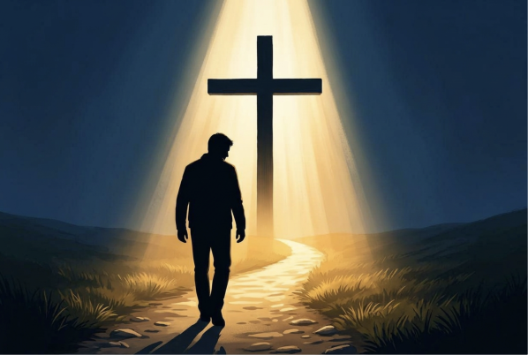
Declared Righteous
Forgiveness Through The Blood Of Christ.
Walking In The Light -
Confession When
We Fail.
“By His Blood”
Revelation 1:5

Slide 11
Praise To God…
For What He Has Done For Us In Christ. (Note Vs. 3, 14)
Here Are The Verbs…
  (3) Blessed Us
  (4) He Chose - Being Holy and Blameless
  (5) He Predestined
  (6) He freely bestowed
  (8) He lavished
  (9) He made known
  (10) Summing up (NASV) To Unite All Things (ESV)
  (11) We Have Obtained - having been predestined - He who works -
  (12) Were (Jews) - First To Hope
  (13) After listening (heard) - Believed - were Sealed In Him
  (14) Is given as a pledge
Ephesians 1:3-14

Slide 12
(NASV - ASV) Reckoned
(LSB - ESV) Counted
(KJV - NKJV) Imputes
(NIV) Credit/Count
Impute?
(6) just as David also speaks of the blessing on the man to whom God credits righteousness apart from works. (7) "BLESSED ARE THOSE WHOSE LAWLESS DEEDS HAVE BEEN FORGIVEN, AND WHOSE SINS HAVE BEEN COVERED. (8) “BLESSED IS THE MAN WHOSE SIN THE LORD WILL NOT TAKE INTO ACCOUNT."
Psalm 32:1-2; Romans 4:6-8
Forgiveness
Not Cloaking…
Romans 3:19-4:8

Slide 13
“He made Him who knew no sin to be sin on our behalf, so that we might become the righteousness of God in Him.”
2 Cor. 5:21
“Then he believed in the LORD; and He reckoned it to him as righteousness.”
What Does It Mean To Be Righteous?
Gen. 15:6
Cf. Romans 4:1-5

Slide 14
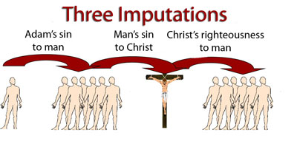
Popular Wrong Concepts

Slide 15
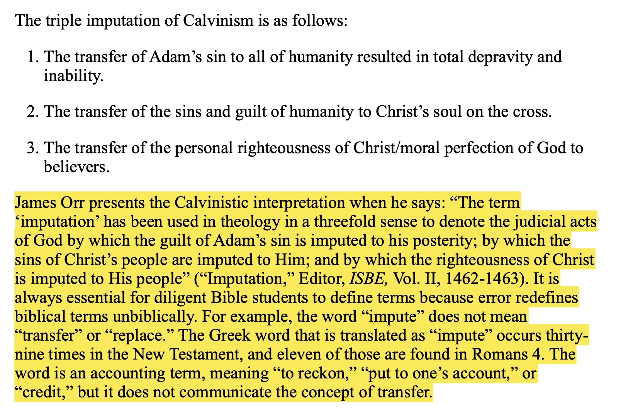

Slide 16

Stretching
The Boundaries
Of What God
Has Spoken?
The Purpose Of Some….

Slide 17
Titus 2:11-15
Tit 2:11 For the grace of God has appeared, bringing salvation to all men,
Tit 2:12 instructing us to deny ungodliness and worldly desires and to live sensibly, righteously and godly in the present age,
Tit 2:13 looking for the blessed hope and the appearing of the glory of our great God and Savior, Christ Jesus,
Tit 2:14 who gave Himself for us to redeem us from every lawless deed, and to purify for Himself a people for His own possession, zealous for good deeds.
Tit 2:15 These things speak and exhort and reprove with all authority. Let no one disregard you.

Slide 18
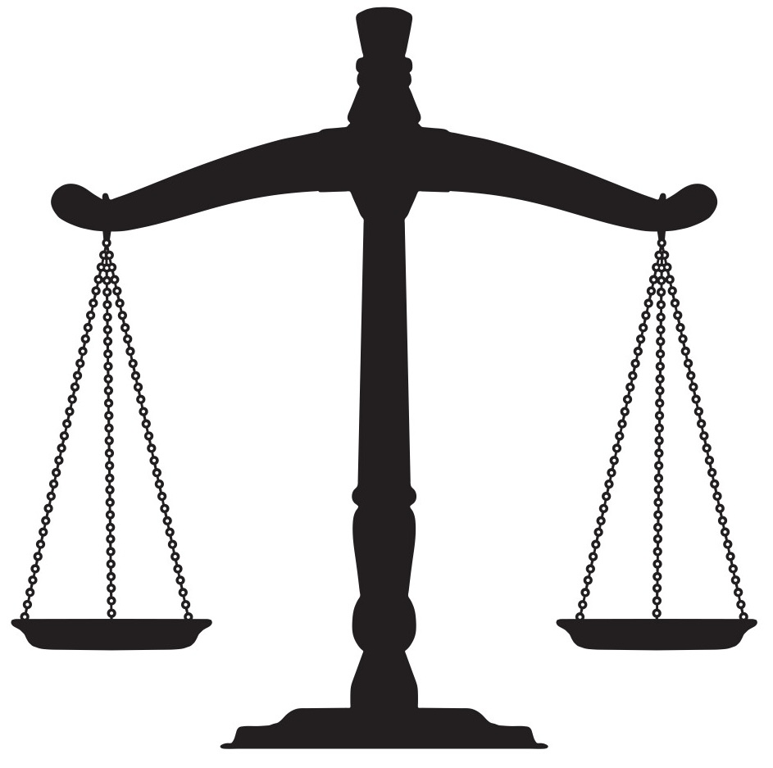
(5) The apostles said to the Lord, “Increase our faith!” (6) And the Lord said, “If you had faith like a mustard seed, you would say to this mulberry tree, ‘Be uprooted and be planted in the sea’; and it would obey you. (7) “Which of you, having a slave plowing or tending sheep, will say to him when he has come in from the field, ‘Come immediately and sit down to eat’? (8) “But will he not say to him, ‘Prepare something for me to eat, and properly clothe yourself and serve me while I eat and drink; and afterward you may eat and drink’? (9) “He does not thank the slave because he did the things which were commanded, does he?
(10) “So you too, when you do all the things which are commanded you, say, ‘We are unworthy slaves; we have done only that which we ought to have done.’”
Luke 17:5-10
Legalism? Working That Earns?
Matthew 23:23

Slide 19
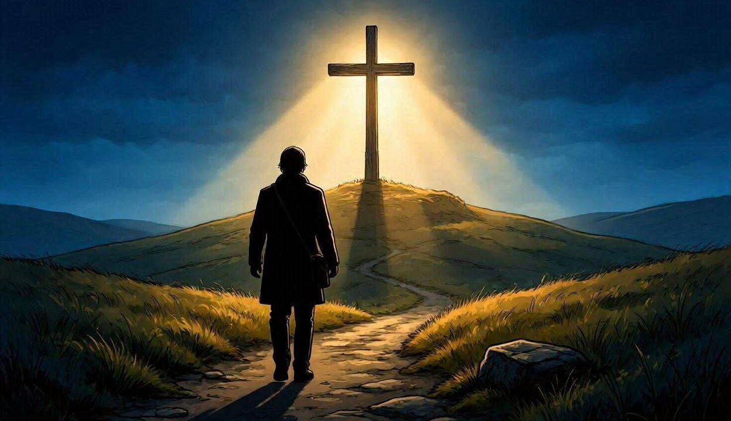
Comfort…
1 John 5:13
“Written That You
May Know…”
Entrance…
Abundantly Supplied…
2 Peter 1:5-11
Through The Wonderful Grace Of God In Christ Jesus!

